Slide 1
PDF & Web Scraping in Python
Aaron Zhu
November 15, 2019

Slide 2


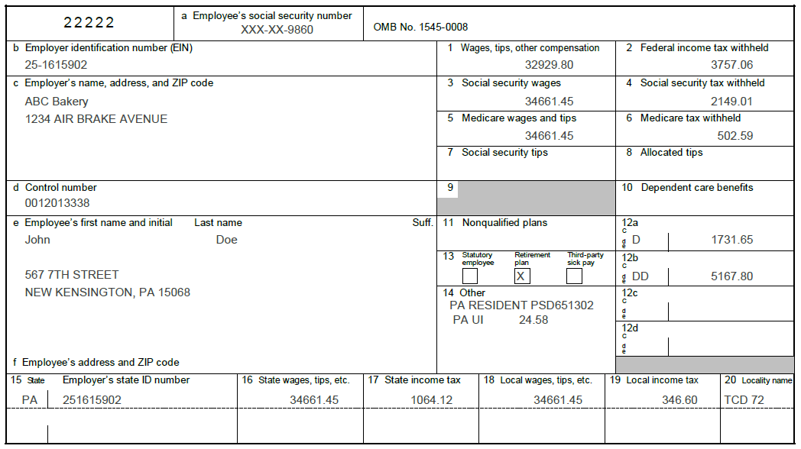
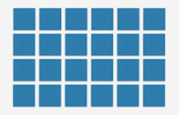
Unstructured Files
Structured Data

Slide 3
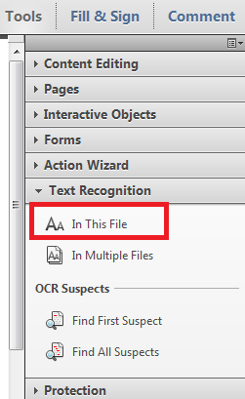
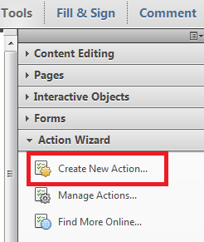
OCR PDF pages in Adobe Acrobat

Slide 4
Unstructured W2 Data

Slide 5

XML FILE
(Data and Metadata)

Slide 6
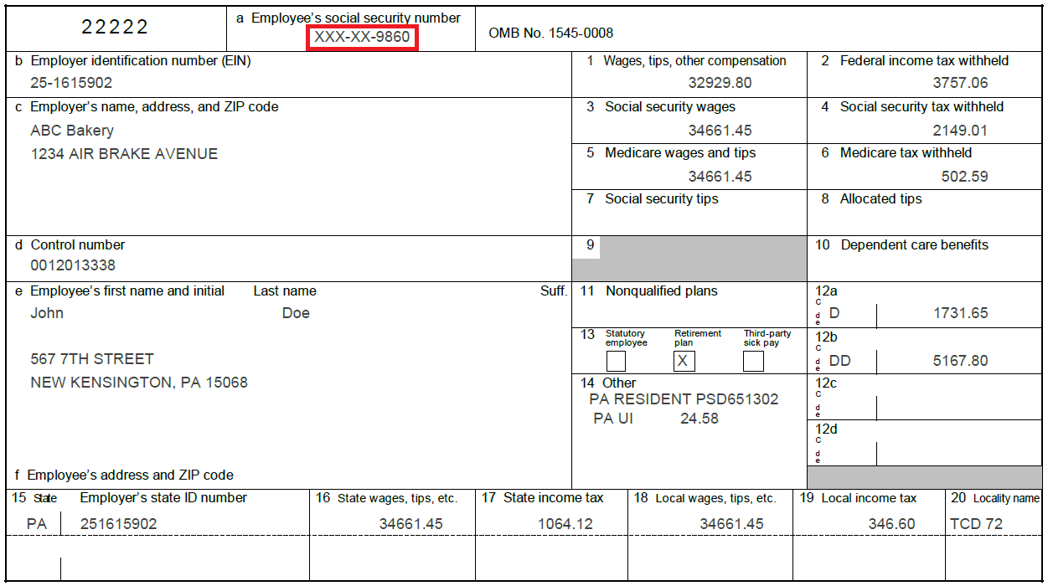


Slide 7
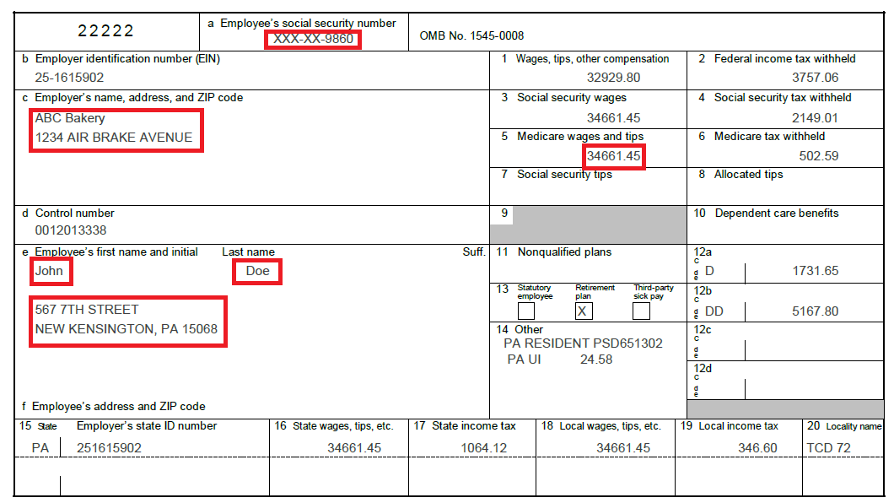

Y1
Y0
Y
0
X0
X1
X

Slide 8
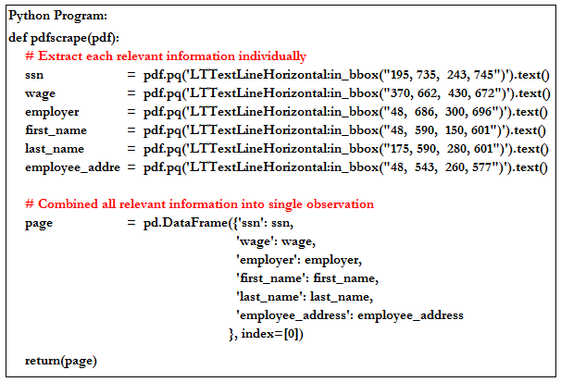

Slide 9
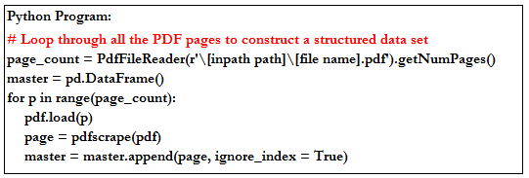
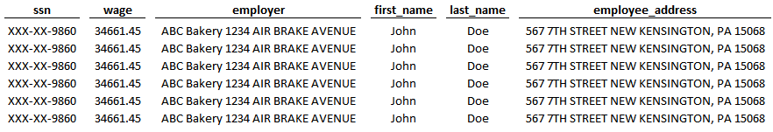

Slide 10
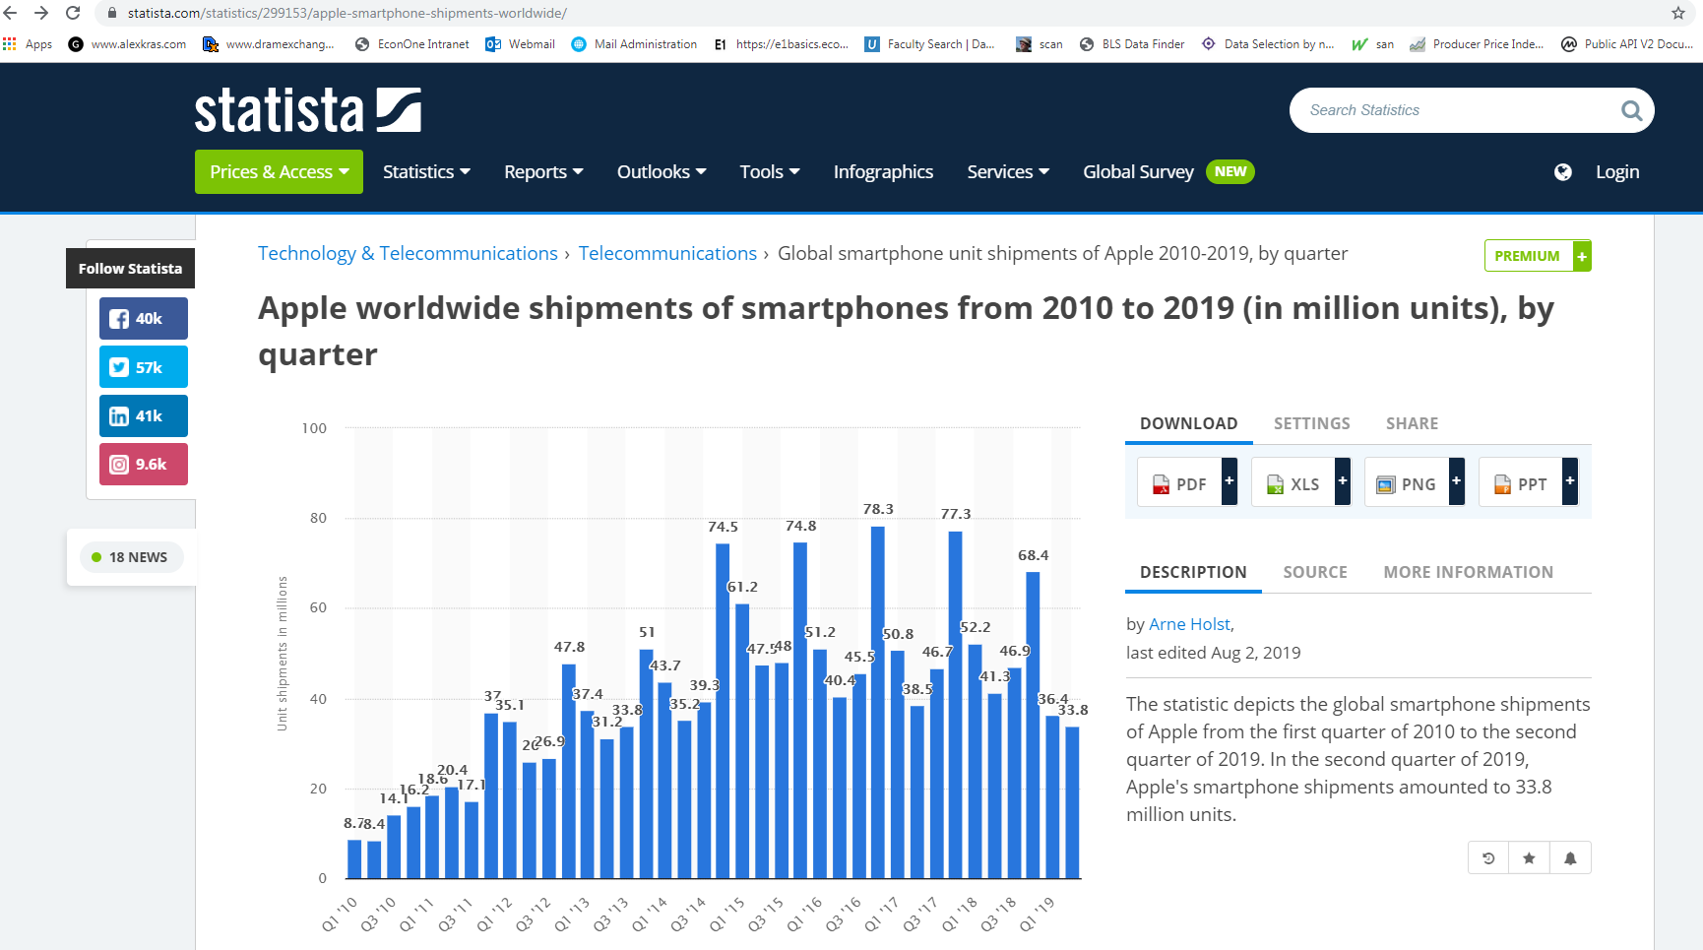
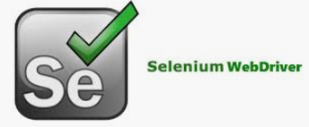

Web-Scraping In Python

Slide 11

HTML
(Source Code of Web Content)

Slide 12
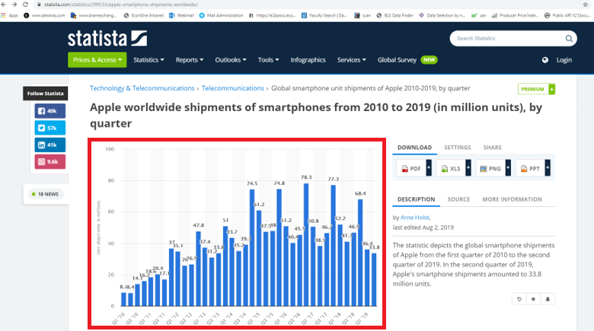
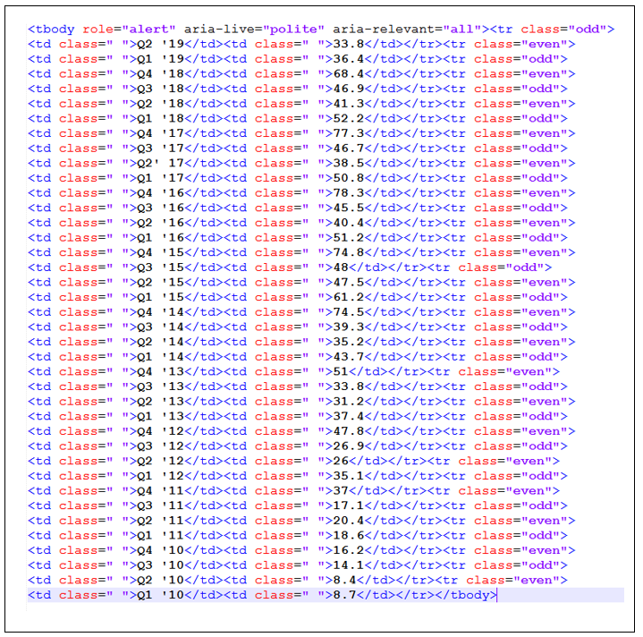
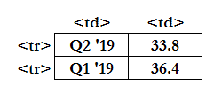
Source Code of Bar Chart

Slide 13
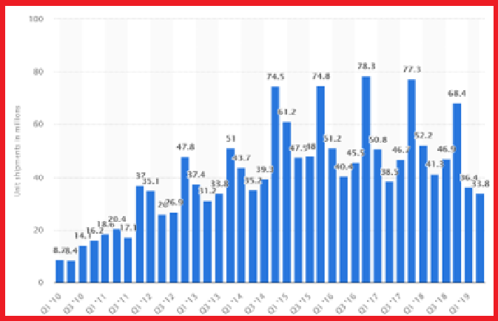
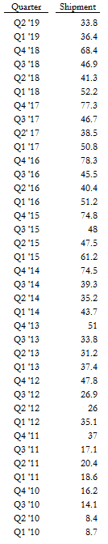
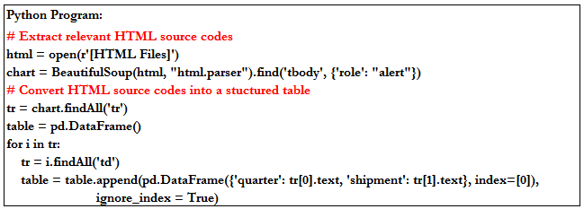
Bar Chart in Website
HTML Source Code
Structured Data

Slide 14
Relevant Tutorials
PDF Scraping
https://github.com/jcushman/pdfquery
Web Scraping
https://www.dataquest.io/blog/web-scraping-tutorial-python/
https://selenium-python.readthedocs.io/

